Slide 1
Incorporation of terms

Slide 2
Signed Contracts

Slide 3
Case: Lost Courier Packet
1. Who has set the terms of offer?
2. Who makes the offer?
3. What are the liabilities of the courier company for the lost packet?
4. Ramesh never read the printed form. He contends that there is no meeting of the minds on the terms as he was not aware of it.

Slide 4
1. Who has set the terms of offer?
2. Who makes the offer?
3. What are the liabilities of the courier company for the lost packet?
The courier company.
The customer by giving the signed form.
Rs. 100. Term 5 of the contract.

Slide 5
Terms and Conditions
1. The sender must mention the complete postal address with pincode. In addition, the telephone number of the receiver must be mentioned.
2. In the case of a consignment which is not a document, the sender will provide the description of the goods and its value.
3. The following articles will not be accepted for carriage:
4. City Express will not provide any insurance coverage for any consignments sent, even if the value of the consignment is declared by the sender or required to be declared by City Express.
5. The liability of City Express for any loss or damage to the shipment is limited to Rs. 100/- for each consignment. Further, City Express will not be responsible for any consequential losses.
6. No compensation or refund will be paid due to late delivery of this consignment”.
7. Queries on consignment should be raised within 30 days from the date dispatch of consignment.
8. Octroi, or any other tax or duty levied on the consignment shall be born by the consignor/consignee. The amount would need to be paid by the consignor/consignee immediately on demand.
9. The sender will be entirely responsible for civil and criminal consequences arising from consigning or attempting to consign any prohibited item listed under clause 3.
10. Any dispute, controversy or claim arising out of or relating to the contract shall be subject to the jurisdiction of Courts of Mumbai.

Slide 6
Ramesh was not aware of the terms. He claims there is no meeting of minds on limiting the damages to Rs. 100.
What principle do we apply for understanding the communication between the parties?

Slide 7
Recall

Slide 9
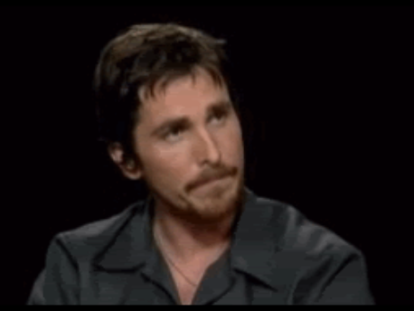
Nod means yes and not no

Slide 10
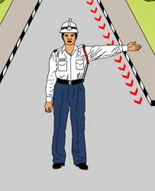
Go to your right even if she intended right.

Slide 11

A cheque for $ 975 even if
inner mind has $ 795.

Slide 12
Case: Lost Courier Packet
A signed document means knowledge and concurrence with the content.
Objective meaning is Ramesh knew of the terms even if he was unaware in his inner mind.
The terms are binding on the parties.

Slide 13
Summary
A contract formed
through a signed document
is binding on the parties.

Slide 14
Bharati Knitting v. DHL Courier
DHL made its customers sign a form containing the terms. Clause 5 of the terms of courier had limited the liability of the DHL in the event of loss of courier to $100.
DHL lost a consignment sent by Bharati Knitting.

Slide 15
The Supreme Court limited the liability of DHL to $100.

Slide 16
The court noted:
‘… a person who signs
a contract terms is bound
by them even though
he has not read them …’

Slide 17
Justice Denning in Curtis Case
‘…people sign printed forms without reading them, only to find afterwards that they contain stringent clauses exempting the other side from their common law liabilities.’

Slide 18
Justice Denning in Curtis Case
‘Signature is irrefutable evidence of his assent to the whole contract, including the exempting clauses…’

Slide 19
Business Practices
Business prefer signed contracts the most as:
These give certainty.
Make possible to include detailed terms.

Slide 20
Consumer Contracts
The sellers or service providers (banks, insurance, telecom) set the pre-printed offeror document and make the customer sign it as the offeror.

Slide 21
B2B Contracts
Business-to-business contracts have come to be done on standard contract terms:
General Conditions of Contract (GCC); and
Special Conditions of Contract (SCC)

Slide 22
Examples:
Formation of contract by signing

Slide 23
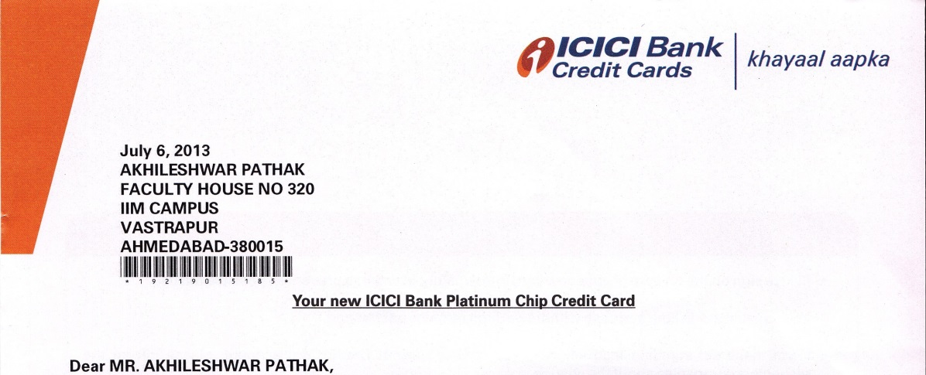
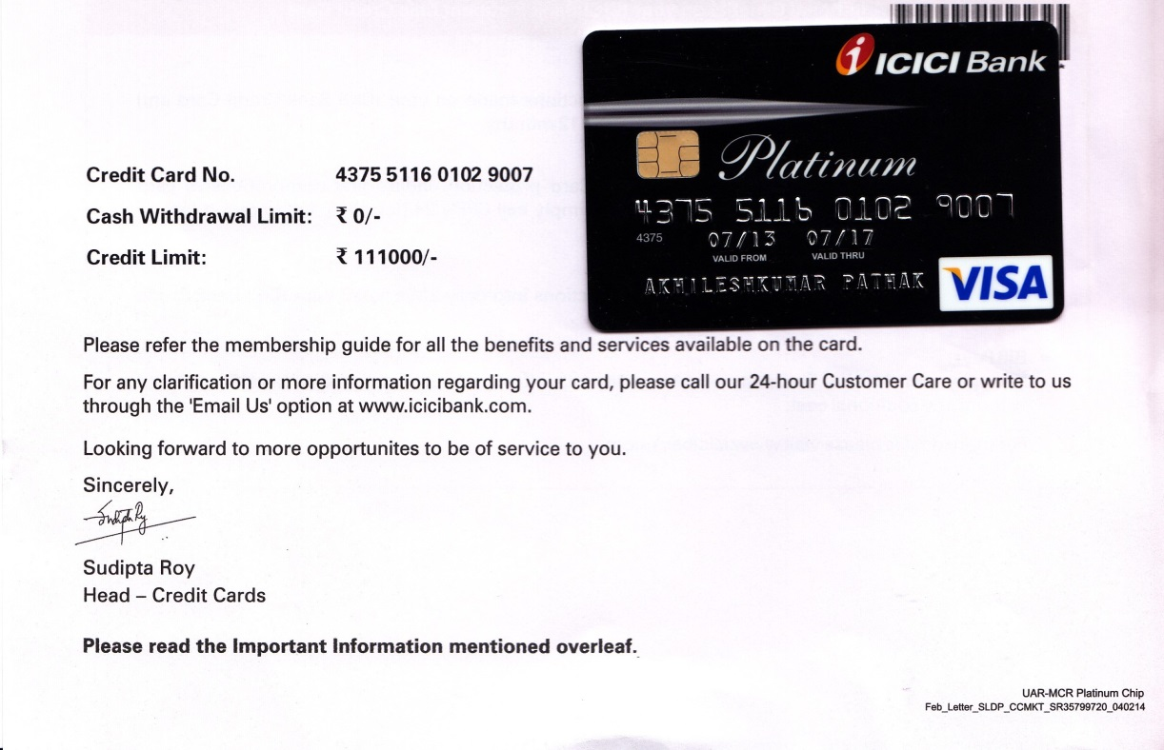
Signed offer of credit card

Slide 24

Terms and Conditions
1. The sender must mention the complete postal address with pincode. In addition, the telephone number of the receiver must be mentioned.
2. In the case of a consignment which is not a document, the sender will provide the description of the goods and its value.
3. The following articles will not be accepted for carriage:
4. City Express will not provide any insurance coverage for any consignments sent, even if the value of the consignment is declared by the sender or required to be declared by City Express.
1. The sender must mention the complete postal address with pincode. In addition, the telephone number of the receiver must be mentioned.
2. In the case of a consignment which is not a document, the sender will provide the description of the goods and its value.
3. The following articles will not be accepted for carriage:
4. City Express will not provide any insurance coverage for any consignments sent, even if the value of the consignment is declared by the sender or required to be declared by City Express.
5. Accept the offer by making a transaction.
6. No compensation or refund will be paid due to late delivery of this consignment”.
7. Queries on consignment should be raised within 30 days from the date dispatch of consignment.
8. Octroi, or any other tax or duty levied on the consignment shall be born by the consignor/consignee. The amount would need to be paid by the consignor/consignee immediately on demand.
9. The sender will be entirely responsible for civil and criminal consequences arising from consigning or attempting to consign any prohibited item listed under clause 3.
10. Any dispute, controversy or claim arising out of or relating to the contract shall be subject to the jurisdiction of Courts of Mumbai.

Slide 25
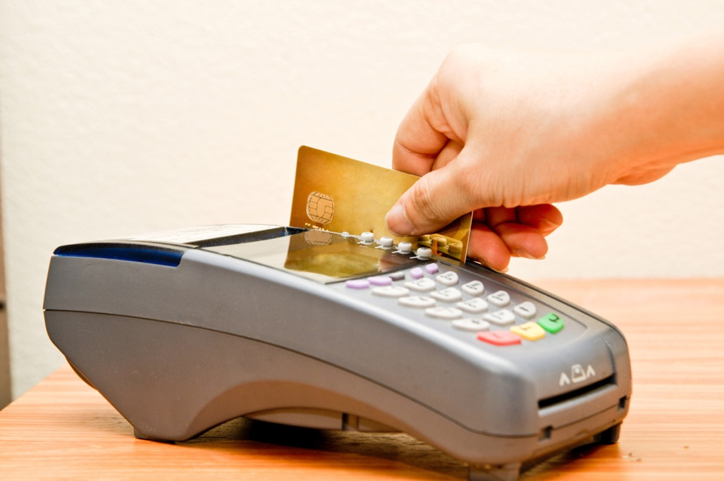
Customer Accepts

Slide 26
Terms and Conditions
1. The sender must mention the complete postal address with pincode. In addition, the telephone number of the receiver must be mentioned.
2. In the case of a consignment which is not a document, the sender will provide the description of the goods and its value.
3. The following articles will not be accepted for carriage:
4. City Express will not provide any insurance coverage for any consignments sent, even if the value of the consignment is declared by the sender or required to be declared by City Express.
1. The sender must mention the complete postal address with pincode. In addition, the telephone number of the receiver must be mentioned.
2. In the case of a consignment which is not a document, the sender will provide the description of the goods and its value.
3. The following articles will not be accepted for carriage:
4. City Express will not provide any insurance coverage for any consignments sent, even if the value of the consignment is declared by the sender or required to be declared by City Express.
5. Accept the offer by calling our 24x7 customer service.
6. No compensation or refund will be paid due to late delivery of this consignment”.
7. Queries on consignment should be raised within 30 days from the date dispatch of consignment.
8. Octroi, or any other tax or duty levied on the consignment shall be born by the consignor/consignee. The amount would need to be paid by the consignor/consignee immediately on demand.
9. The sender will be entirely responsible for civil and criminal consequences arising from consigning or attempting to consign any prohibited item listed under clause 3.
10. Any dispute, controversy or claim arising out of or relating to the contract shall be subject to the jurisdiction of Courts of Mumbai.

Slide 27

Customer Accepts

Slide 28
Terms and Conditions
1. The sender must mention the complete postal address with pincode. In addition, the telephone number of the receiver must be mentioned.
2. In the case of a consignment which is not a document, the sender will provide the description of the goods and its value.
3. The following articles will not be accepted for carriage:
4. City Express will not provide any insurance coverage for any consignments sent, even if the value of the consignment is declared by the sender or required to be declared by City Express.
1. The sender must mention the complete postal address with pincode. In addition, the telephone number of the receiver must be mentioned.
2. In the case of a consignment which is not a document, the sender will provide the description of the goods and its value.
3. The following articles will not be accepted for carriage:
4. City Express will not provide any insurance coverage for any consignments sent, even if the value of the consignment is declared by the sender or required to be declared by City Express.
5. Accept the offer by sending sms ‘accepted’ from your registered mobile.
6. No compensation or refund will be paid due to late delivery of this consignment”.
7. Queries on consignment should be raised within 30 days from the date dispatch of consignment.
8. Octroi, or any other tax or duty levied on the consignment shall be born by the consignor/consignee. The amount would need to be paid by the consignor/consignee immediately on demand.
9. The sender will be entirely responsible for civil and criminal consequences arising from consigning or attempting to consign any prohibited item listed under clause 3.
10. Any dispute, controversy or claim arising out of or relating to the contract shall be subject to the jurisdiction of Courts of Mumbai.

Slide 29

Customer Accepts

Slide 30
A signed offer document,
on acceptance,
forms a contract by signing.

Slide 31
Acceptance need not
be signed.

Slide 32
Both the parties need
not sign a contract document.

Slide 33
Electronic Communications
Information Technology Act, 2000 insists that every electronic record is to be taken to be a signed document.

Slide 34
Equivalent to Signing
Every electronic communication through computers, smart phones, internet, ATMs, servers, tablets or similar means are equivalent to the person taking a print out and signing it.

Slide 35
Electronic Signature
The signature can be digital signature, password, pin numbers, biometric reading like finger print, attaching scanned signature or email account.
If not, it is the account or the owner of the computer from which the record originates.

Slide 36
Tickets, Vouchers
and Receipts

Slide 37
Wrong Show
Customer: ‘Two tickets, gold, Rs. 250 tickets, 3-6 show of Moonlight.’
Clerk: ‘Yes sir.’
The clerk printed the tickets. The customer gave Rs. 500 and the clerk, the tickets.
Who offered?
The customer. ‘Two tickets, gold, Rs. 250 tickets, 3-6 show of Moonlight.’
When is an agreement made?
When the clerk said: ‘Yes sir’

Slide 38


Sequence of Events
Customer Theatre
Offer
Acceptance
Agreement
Payment
Ticket (with terms)

Slide 39

New World Theatres
If the theatre is not able to screen a film due to technical reasons or otherwise, it will screen another film and there will be no refund for the ticketholders.
Was the above term a part of the offer by the customer?
No
The term is not binding as it came after
the agreement was made.

Slide 40
The law is slightly more nuanced.
Terms beneficial to the customer are binding.
Terms which are ordinary, usual or reasonable are binding.
Terms which are unusual, onerous or harsh on the customer are not binding unless adequate notice of the terms is given.

Slide 41

New World Theatre
Avail of the 30% discount on one large popcorn.
Suitcases and big baggage are not allowed inside the theatre. Kindly leave with the theatre security.
If the theatre is not able to screen a film due to technical reasons or otherwise, it will screen another film and there will be no refund for the ticketholders.
Binding, beneficial to the customer.
Binding, reasonable and usual.
Not binding, harsh and onerous.

Slide 42
Tickets, vouchers and receipt
Examples

Slide 43
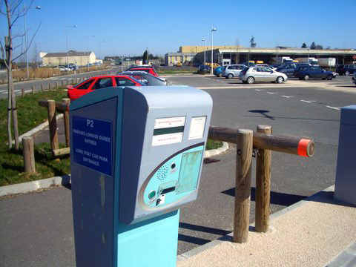
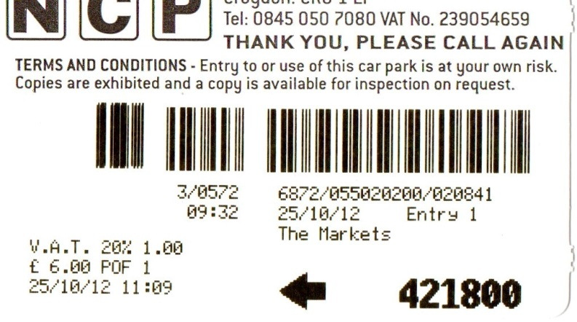
Car park tickets

Slide 44

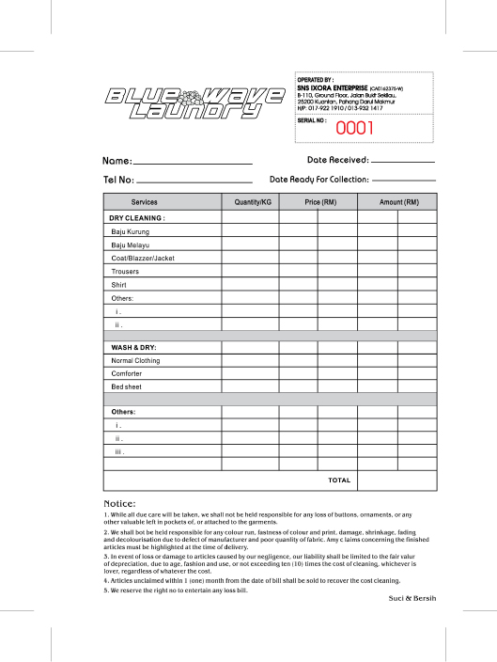
Laundry Receipt

Slide 45
Case: Past Practices
It was a term of the past four dealings that the garage would not be liable for losses. The fifth time, the garage took the car from the road. Should the term be implied?
The courts never imply past dealings or trade practices in consumer contracts.
Even in business contracts, very stringent criterion is set for it to apply. The only case in which it has got applied is:
British Crane Hire Corporation v. Ipswich Plant Hire Limited

Slide 46
Incorporation
Summary:
Signing is the best mode of ensuring that the terms become a part of the contract.
Giving notice of terms on tickets and vouchers is the next.
Terms never get implied from past dealings and trade practices. These are most inadequate.

Slide 47
Exercise: Incorporation of Contract Terms
Signed contracts, tickets, vouchers and past practices

Slide 48
1. Receipt 2. Receipt 3. Receipt 4. Signed contract 5. Like receipt- post contract | 6. Past practices 7. Signed contract 8. Signed contract 9. Signed contract 10. Signed contract

Slide 49
Modifying the offer form
The customer changed the terms, signed and submitted to the bank. The bank accepted it.
Who made the offer?
When was the offer accepted?
Are the terms of the contract binding?
Is there any unlawfulness in the contract?
Jeet, the customer
Customer received acceptance and card.
Yes. Signed offer bind
?

Slide 50
Decide if sending following offer letter to a company is unlawful
Sr. | Letter
1 | To internship for 2 months for Rs 2 lakhs
2 | Sell a packing machine for Rs. 32 lakhs
3 | Courier service for Rs. 200 a letter
4 | Car rentals, Rs 1000 a day
5 | Sell contraband goods
6 | Secure a licence through bribe
7 | Appointed sales executive
8 | Appointed sales managers
9 | Take over the company as chief executive!
No
No
No
No
Yes
Yes
No
No
No

Slide 51
A contract is formed.
Only its contents
can make it void.

Slide 52
Part Written and Oral Contract
Written sale contract- no delivery date.
Same day an oral contract for delivery within five days.
Should the two be read together?

Slide 53
Part Written and Oral Contract
Courts asked: Why do parties enter into a written agreement?
And answered: To bring certainty, clarity and create record. They would write all that they wanted to be binding. There is nothing beyond the written terms.
Thus, the court will not receive oral evidence to qualify written contract. (Parol evidence Rule)
Parol means word of mouth or verbal.
But

Slide 54
Opposing view
Parties are free to communicate by any means, writing, orally, impliedly and a combination of these.
The parties can create a part oral and part written contract. How would the court know unless it entertains the claim?
The courts cannot refuse to explore the claim.

Slide 55
Court to balance conflict
Parol Evidence Rule
Right of access to court
Do not receive claim of oral contract
Cannot refuse to hear a claim of oral contract

Slide 56
Lord Russell in Gillespie Bros. & Co. v Cheney, Eggar & Co., [1986 2 QB 59]
… when the parties arrive at a definite written contract the implication or presumption is very strong that such contract is intended to contain all the terms of their bargain, it is a presumption only, and it is open to either of the parties to allege …

Slide 57
Court of Appeal in Burley v Joseph W Burley Partners Ltd [2002] EWCA Civ 1163
It cannot therefore be asserted that, in modern times, the mere production of a written agreement, however complete it may look will as a matter of law render inadmissible evidence of other terms not included expressly or by reference in the document. ‘The court is entitled to look at and should look at all the evidence from start to finish in order to see what the bargain was that was struck between the parties.'”

Slide 58
Court of Appeal in: T/A Hamid Properties v Francis Bradshaw Partnership, [2013] EWCA Civ 470.
The parol evidence rule has been part of the common law for over two centuries. This provides that where there is a written contract, oral evidence cannot be received to add to, subtract from or vary the written terms.
There are a number of exceptions to the parol evidence rule and these have increased in recent years. This may in part be due to the increasing ease and speed with which documents can be created and dispatched. The temptations of the keyboard, the ‘cut and paste’ facility and the mouse cannot always be resisted.

Slide 59
Diageo plc v Mallya
Queen's Bench Division (Commercial Court)
24 May 2019
https://www.thehindubusinessline.com/news/diageo-wins-usd-135-million-claim-against-mallya-in-uk-court/article27246650.ece
https://economictimes.indiatimes.com/news/politics-and-nation/uk-court-hears-diageo-usd-175-million-claim-against-vijay-mallya/articleshow/69487777.cms
https://www.business-standard.com/article/pti-stories/diageo-wins-usd-135mn-claim-against-mallya-in-uk-court-119052401767_1.html

Slide 60
Entire Agreement Clause:
This agreement constitutes the entire agreement between the parties and supersedes and extinguishes all previous discussions, correspondence, negotiations, drafts, agreements, promises, assurances, warranties, representations and understandings between them, whether written or oral, relating to its subject matter.

Slide 62
References

